Slide 1


Uninstallable by Design The Role of Pre-installed Apps in Android’s Security Landscape
OWASP Switzerland Community Meetup
February 2025

Slide 2

Content
Focus is on the Android OS for smartphones:
What are pre-installed apps?
How Android Verified Boot works
Why we can’t uninstall pre-installed apps
Academic case study
How we analysed pre-installed apps
Challenges and solutions
Future Work in this field

Slide 3



Who am I
Software Engineering Group
Institute of Computer Science
University of Bern
https://seg.inf.unibe.ch/
Information Security Group
Institute of Computer Science
Zurich University of Applied Sciences
https://www.zhaw.ch/en/engineering/institutes-centres/init/information-security
Thomas Sutter
PhD Student @ Uni-Bern
Computer Science
https://7homassutter.github.io

Slide 4
What are pre-installed apps?

Slide 5
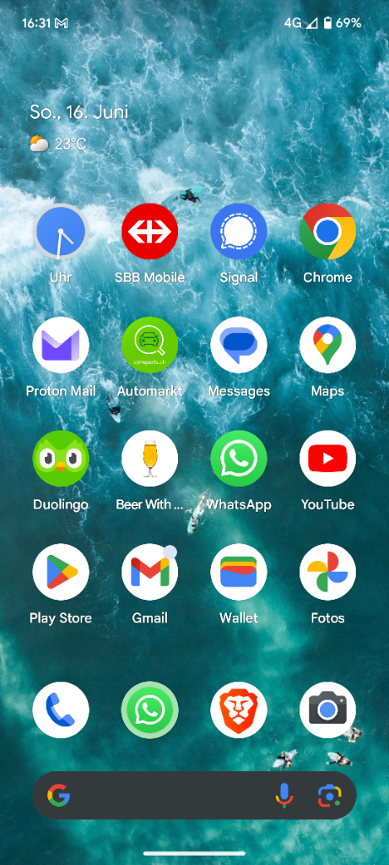
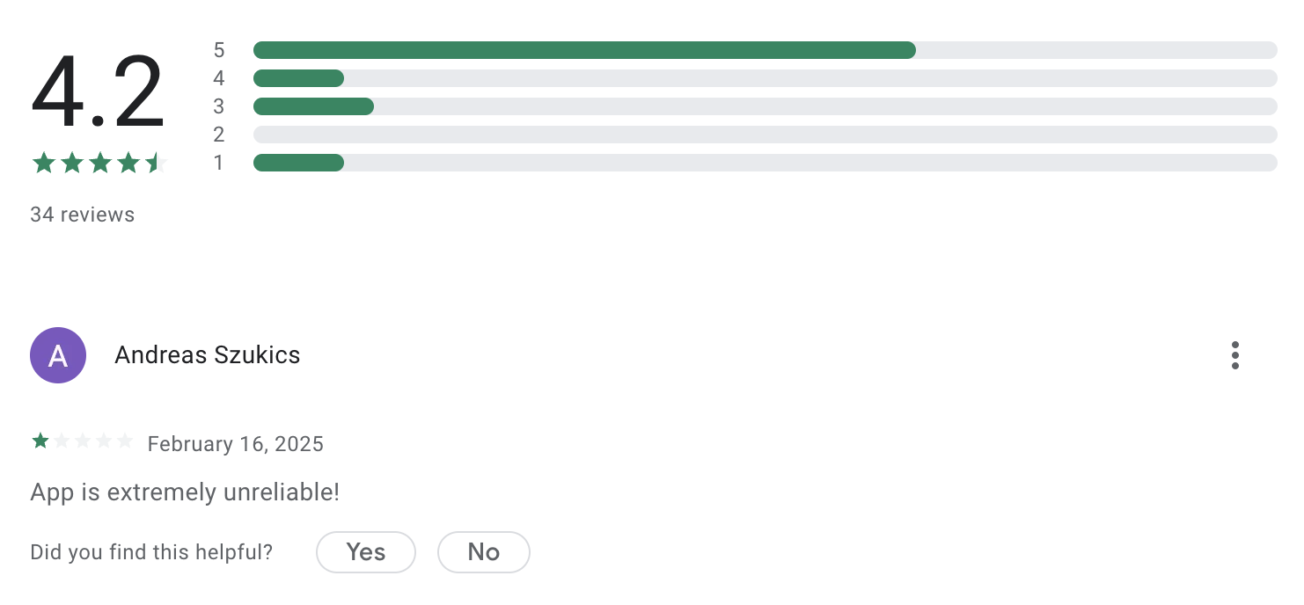
Different Types of Apps
Userspace Apps
Apps installed over an app store
User reviews available
Users can decide to uninstall apps
Apps have limited access rights
Apps are stored in the “.apk” file format, which is basically a zip file

Slide 6
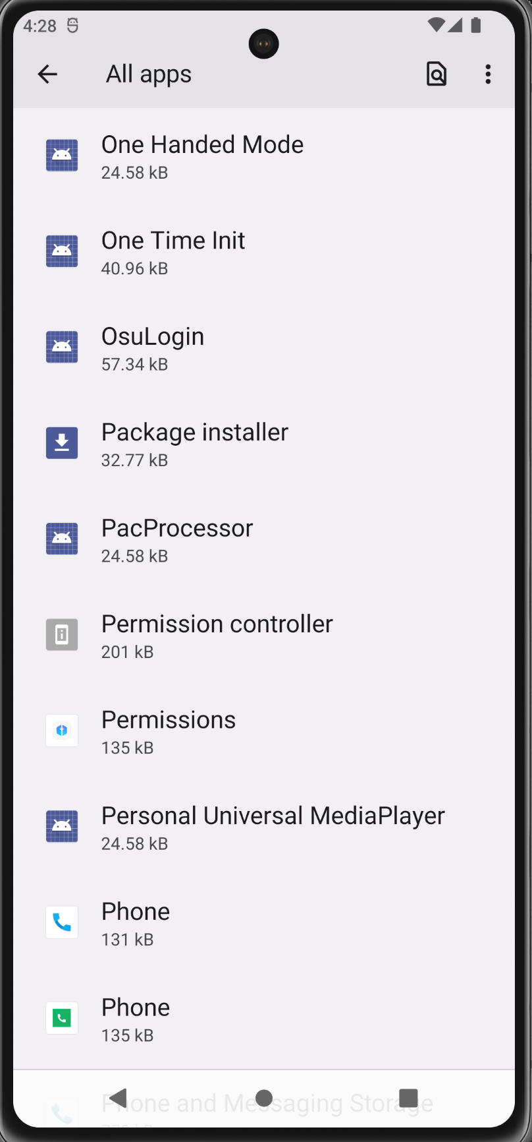
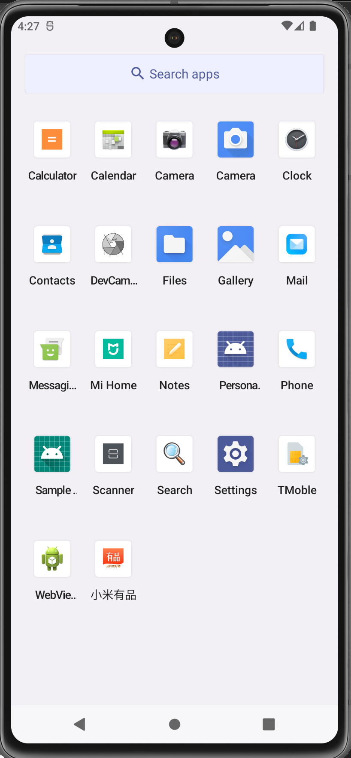
Different Types of Apps
Pre-installed Apps
Pre-installed apps are all the Android applications that are shipped with a stock device. For instance:
Telephone app
Contacts app
System service
Headless apps
…
How do these apps end up on our phones?

Slide 7












Android’s Supply Chain
Core Manufacturers
Vendors
Third-Party Apps
Suppliers
Manufacturer apps
Vendor apps
Product apps
Software and Services
Cloud
Software
packages
Shipped & Deployed
Android Firmware
Android Device

Slide 8
Why are these apps interesting?

Slide 9





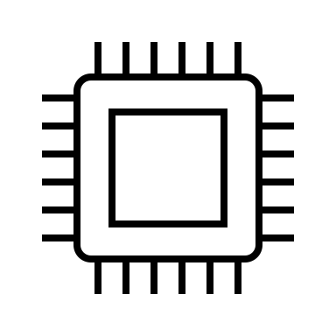
Android Verified Boot (simplified)
Bootloaders
(ROM + Flash)
Device partitions
Hardware
Root of Trust
Linux Kernel
System
Kernel
Read
Partition Signature (Merkle Tree)
Partition Signature (Merkle Tree)
User
Read + Write
Vendor
Crypto Chip (SE / TEE)
VBMeta
Read
ROM part verifies flash bootloader (updates)
Flash part verifies kernel
Verification with the “Bootloader key”
Partition Signature (Merkle Tree)
VBMeta includes the cryptographic meta-data
(public keys) from different sources
(Vendors, ODM, …)
Product
Read
Partition Signature (Merkle Tree)
…
Read
“Unchangable” (on chip):
Bootloader key (asymmetric)
Device unique key (symmetric)
Programmable:
Android Root of Trust (asymmetric)
Partition Signature (Merkle Tree)
DM-Verity only works for read-only partitions
Verification is done before mount and during
FS-verity for specific files runtime

Slide 10

Locating The Apps
boot partition.
kernel
ramdisk
init_boot partition
system partition
odm partition
odm_dlkm partition
recovery partition
cache partition
misc partition
userdata partition
metadata partition
vendor partition
vendor_dlkm partition
radio partition
tos partition
pvmfw partition
…
System
Read
User
/apex
Read + Write
/app
Vendor
Kernel
Read
/priv-app
Product
/overlay
Read
ODM
/framework
Read
System_ext
/…
Read
More infos: https://source.android.com/docs/core/architecture/partitions

Slide 11
Why are partitions read-only anyways?
Minimizing attack surface during runtime
Sandboxing
Performance
User Experience
Files on read-only partitions cannot simply be deleted
Consequenlty, pre-installed apps cannot be uninstalled

Slide 12

Users have no way to remove these apps
Only by jailbreaking or rooting, which is not a real option for normal users

Slide 13
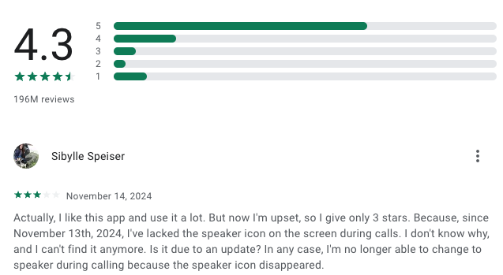
Users have no way to remove these apps
Only by jailbreaking or rooting, which is not a real option for normal users
No app store for pre-installed apps
No review possibility
No publicly known security controls
No app classification or description
Apps cannot easily be installed

Slide 14

Users have no way to remove these apps
Only by jailbreaking or rooting, which is not a real option for normal users
No app store for pre-installed apps
No review possibility
No publicly known security controls
No app classification or description
Apps cannot easily be installed
Pre-installed app have lots of permissions

Slide 15

Users have no way to remove these apps
Only by jailbreaking or rooting, which is not a real option for normal users
No app store for pre-installed apps
No review possibility
No publicly known security controls
No app classification or description
Apps cannot easily be installed
Pre-installed app have lots of permissions
Patching cycles are long and vendors sell space on their products

Slide 16
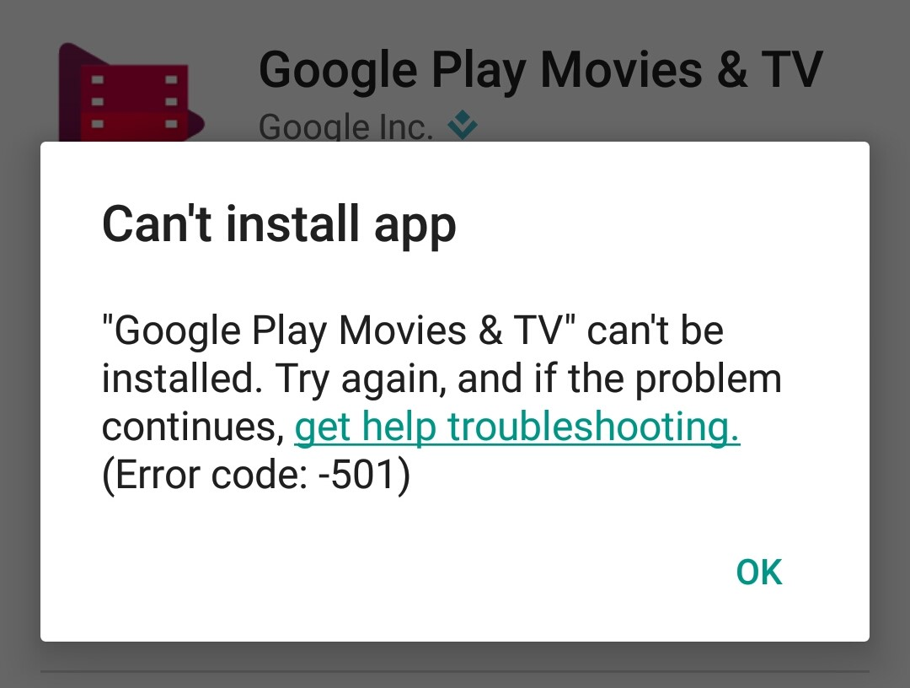
Users have no way to remove these apps
Only by jailbreaking or rooting, which is not a real option for normal users
No app store for pre-installed apps
No review possibility
No publicly known security controls
No app classification or description
Apps cannot easily be installed
Pre-installed app have lots of permissions
Patching cycles are long and vendors sell space on their products
Security practioners have problems analysing them on scale and in-depth at runtime
Installation is not simply possible
Dependencies to files and services

Slide 17
Pre-Installed Nightmares?

Slide 18
History of Incidents
2017
2018
2019
2020
2021
2022
2023
2024

Slide 19
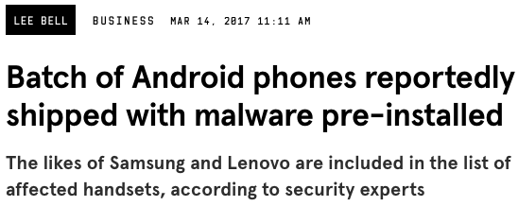
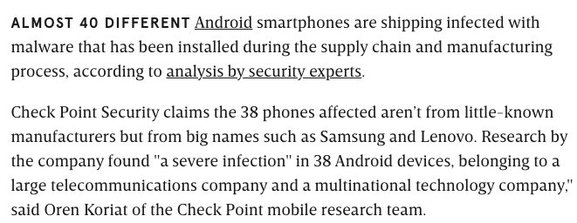
History of Incidents
2017
2018
2019
2020
2021
2022
2023
2024
Malware shipped with 40 Vendors
Pre-installed Chamois
https://www.wired.com/story/android-phones-hiding-pre-installed-malware/

Slide 20
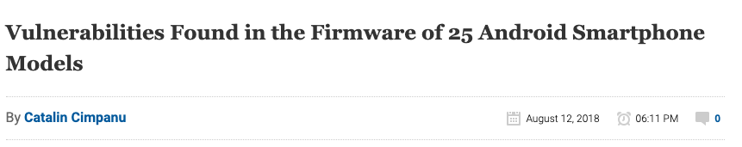
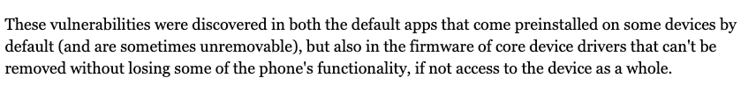
History of Incidents
2017
2018
2019
2020
2021
2022
2023
2024
Malware shipped with 40 Vendors
25 Vulnerable Smartphone Models
Pre-installed Chamois
https://www.bleepingcomputer.com/news/security/vulnerabilities-found-in-the-firmware-of-25-android-smartphone-models/

Slide 21
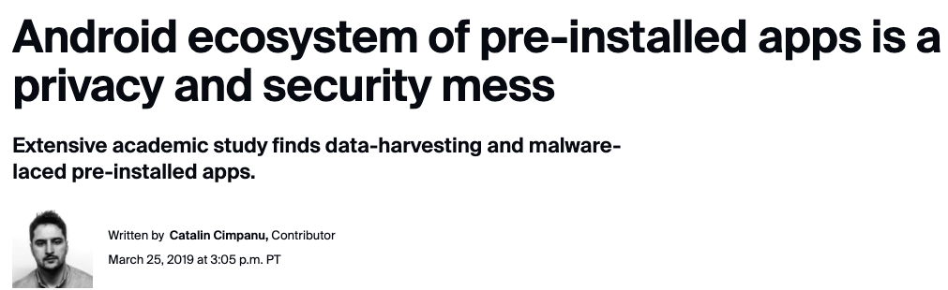
History of Incidents
2017
2018
2019
2020
2021
2022
2023
2024
Malware shipped with 40 Vendors
25 Vulnerable Smartphone Models
Data harvesting by Gamba et al.
Pre-installed Chamois
https://www.zdnet.com/article/android-ecosystem-of-pre-installed-apps-is-a-privacy-and-security-mess/
Paper: “An Analysis of Pre-installed Android Software” by Gamba et al.

Slide 22
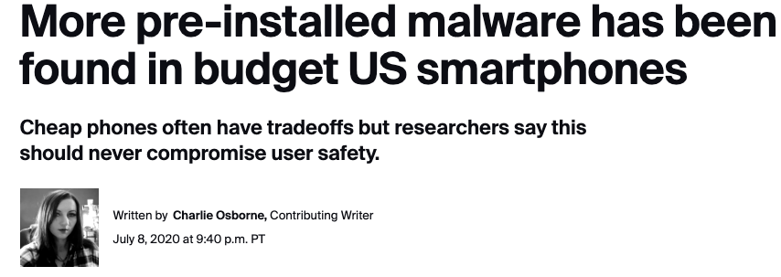
History of Incidents
2017
2018
2019
2020
2021
2022
2023
2024
Malware shipped with 40 Vendors
25 Vulnerable Smartphone Models
Data harvesting by Gamba et al.
Malware on US budget phones
Pre-installed Chamois
https://www.zdnet.com/article/more-pre-installed-malware-has-been-found-in-budget-us-smartphones/

Slide 23
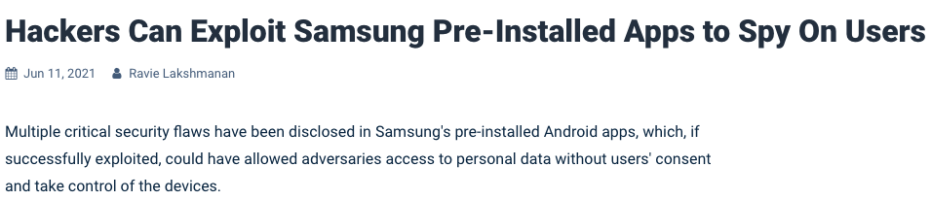
History of Incidents
2017
2018
2019
2020
2021
2022
2023
2024
Malware shipped with 40 Vendors
25 Vulnerable Smartphone Models
Data harvesting by Gamba et al.
Malware on US budget phones
Critical vulnerabilities found
Pre-installed Chamois
https://thehackernews.com/2021/06/hackers-can-exploit-samsung-pre.html

Slide 24
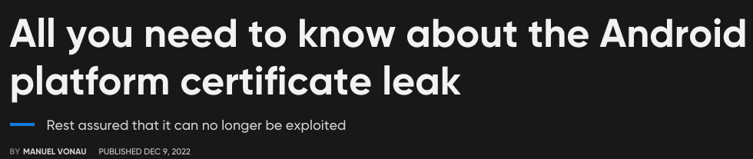
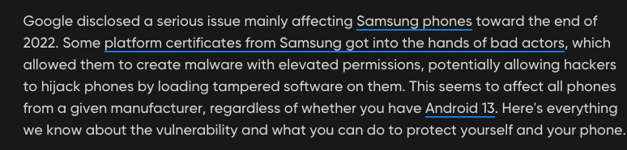
History of Incidents
2017
2018
2019
2020
2021
2022
2023
2024
Malware shipped with 40 Vendors
25 Vulnerable Smartphone Models
Data harvesting by Gamba et al.
Malware on US budget phones
Platform Certificates leaked
Critical vulnerabilities found
Pre-installed Chamois
https://www.androidpolice.com/android-platform-certificate-leak-explainer/

Slide 25
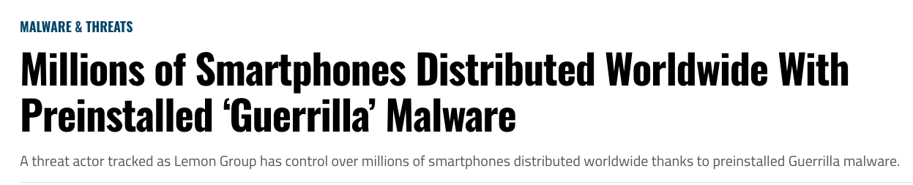
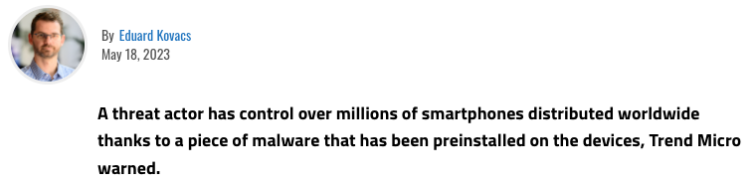
History of Incidents
2017
2018
2019
2020
2021
2022
2023
2024
Malware shipped with 40 Vendors
25 Vulnerable Smartphone Models
Data harvesting by Gamba et al.
Malware on US budget phones
Platform Certificates leaked
Critical vulnerabilities found
Pre-installed “Guerrilla”
Pre-installed Chamois
smartphones, watches, TVs, and TV boxes
https://www.securityweek.com/millions-of-smartphones-distributed-worldwide-with-preinstalled-guerrilla-malware/

Slide 26
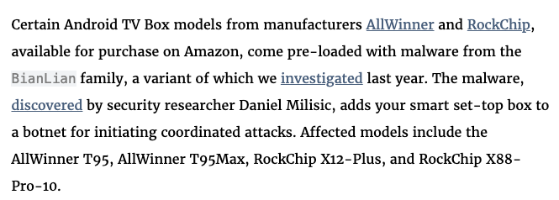
History of Incidents
2017
2018
2019
2020
2021
2022
2023
2024
Malware shipped with 40 Vendors
25 Vulnerable Smartphone Models
Data harvesting by Gamba et al.
Malware on US budget phones
Platform Certificates leaked
Critical vulnerabilities found
Pre-installed “Guerrilla”
Pre-installed Chamois
smartphones, watches, TVs, and TV boxes
One Down, Many to Go with Pre-Installed Malware on Android
https://www.eff.org/deeplinks/2024/11/one-down-many-go-pre-installed-malware-android

Slide 27
Research Motivation
According to our research, and by research I mean “googling”, there seems to be an issue with the security and privacy of pre-installed apps…
Our main goal is to make the analysis less laboursome.
Basically, lowering the bar for researchers to start analysing these apps
Have some tooling to support the analysis
Figuring out if there is any good existing tools for the job
Compare different Android firmware
Learn what is shipped on our Android devices
Hopefully, find some cool vulnerabilities
Maybe writing some papers about it

Slide 28

Plan for the Case Study
Get Sample Data
Extract Apps
Scan These Apps
Profit

Slide 29
Getting The Sample Data

Slide 30
Where to find the data?
Extracting firmware/apps from devices?
Crowed-sourcing?

Slide 31
Where to find the data?
Extracting firmware/apps from devices?
Crowed-sourcing?
Official vendor website?
Mostly not existing

Slide 32
Where to Firmware Samples?
Extracting firmware/apps from devices?
Crowed-sourcing?
Official vendor website?
Mostly not existing
Shady webforums
Many websites claiming to have ”official” stock firmware
Firmware taken from update servers
Custom firmware
Fake “stock” firmware

Slide 33
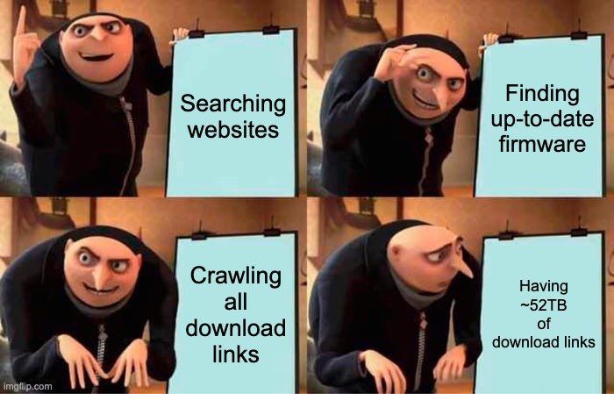
Crawling For Firmware
Developed a small 321 lines of code web-crawler. Just to collect some download links from various websites…
…worked better than expected

Slide 34
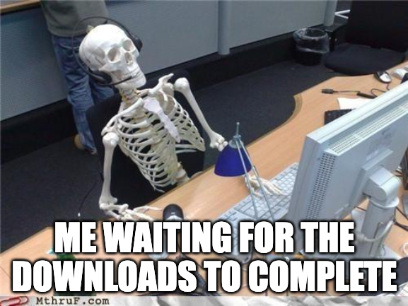
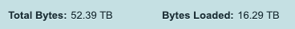
Let’s Get Research Data
2021: We collected around ~10TB of firmware samples
2023: We collected links for ~52TB and downloaded another ~16TB
of samples for our current study
Basically, we found download links to all Android versions (v4 to v15)
For free
Including official stock ROMs, fake stock ROMS, and customs ROMs
Data is available for academic researchers…
For the others: I might have a text file with some download links, that I’m eventually willing to share

Slide 35


A Word on File Formats
Compression Formats
Partition Formats
Android container formats
.zip
.tar
.gzip
.7z
.lz4
.bin
.dat
.br
.nb0
.pac
.ubi
.ozip
…
.ext2
.ext4
.sparse
.f2fs
.erofs
.payload_bin
.img
.bin
.raw
.super
…
.apex
.apk
.aab
…
Not including formats for kernel, radio, tos, pvmfw, cache, …

Slide 36
Developing an Extraction Routine
Maybe some of you know the tool “unblob”
Upsides:
Really handy to extract compressed files and some partitions
Supports Android sparse images
Downsides:
Performance is often slow in case of large firmware
Android custom firmware formats not supported
Extraction depth is hard to set
Came out years after me implementing an extraction routine
Developed an own extraction routine with a mix of state-of-the-art tools and mounting tools to handle Android’s mix of file formats
2021: We were able to extract ~8’000 samples
2024: We were able to extract ~20k samples
Still open challenges in doing this stable, generic, and fast

Slide 37
Digging Into The Data

Slide 38
Developing FirmwareDroid (FMD): The Pipeline
Image from our paper: https://ieeexplore.ieee.org/document/10172951
Implemented this tool back in 2020 as part of my master thesis and we did some experiments:
Detecting Malware
Searching Vulnerabilities
Permission Analysis
Tracker Analysis

Slide 39
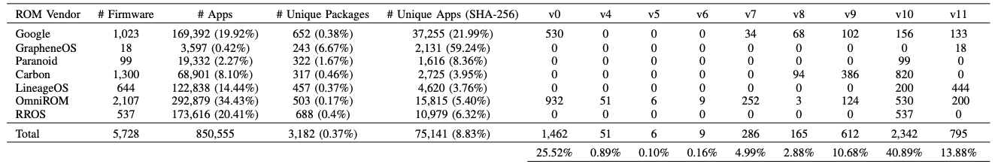
Case Study: 2021
Table from our paper: https://ieeexplore.ieee.org/document/10172951
5,728 firmware samples for experimenting with 75,141 unique apps
We used firmware from seven vendors that share their firmware on an official channel and at no cost
Focus:
Android 10 and 11
Static Analysis with existing tooling
Permissions used
Trackers identified

Slide 40
Android Permissions Expectations
There are three main permission levels on Android:
High Risk
Least common
Normal
Dangerous
Signature
Moderate or High Risk
Common for pre-installed apps
Low Risk
Most common
Hypothesis: If we scan the apps in our database, we expect to see a kind of pyramid distribution

Slide 41
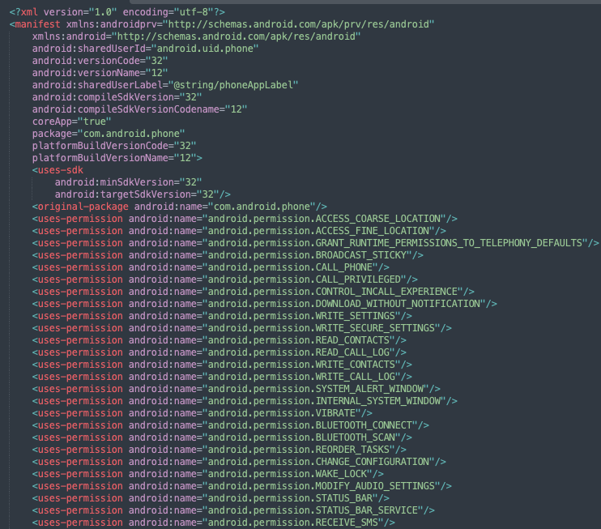

Getting Permission Data
AndroidManifest.xml from “com.android.phone”
Database of
75,141 Pre-Installed Apps
Apk files
Extract Permissions
Image source: https://github.com/androguard/androguard
“Androguard is a full python tool to play with Android files.” – AndroGuard Devs

Slide 42
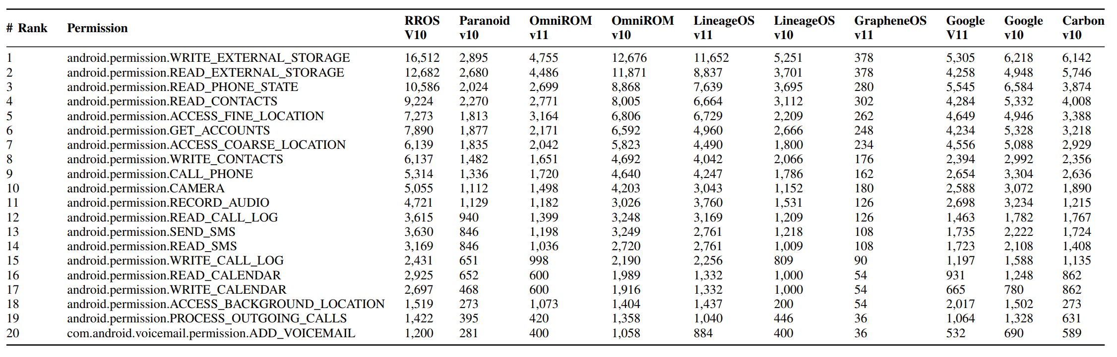
Permission Analysis
﻿Top 20 requested dangerous permissions for pre-installed apps on Android 10 and 11
Table from our paper: https://ieeexplore.ieee.org/document/10172951
﻿88.14% of the permissions are signature.
28.57% of the permissions in our dataset are custom third-party permissions.
3.56% are dangerous.
8.21% are normal declared permissions.

Slide 43

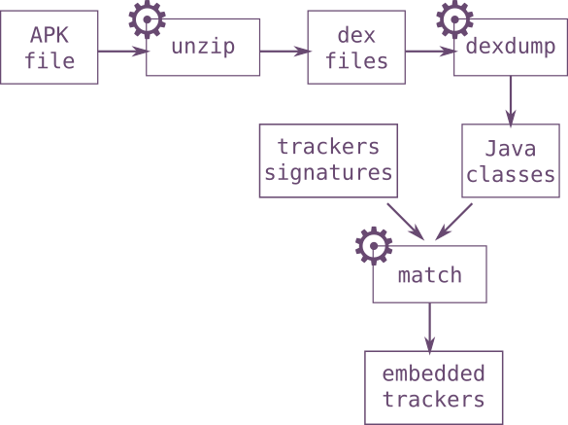
Tracking The Trackers
﻿A tracker is a piece of software that logs the behaviour of a program or user.
Exodus: https://github.com/Exodus-Privacy/exodus-core
«εxodus analyses Android applications. It looks for embedded trackers and lists them. A tracker is a piece of software meant to collect data about you or what you do. In a way, εxodus reports are a way of knowing what really are the ingredients of the cake you are eating. εxodus does not decompile applications, its analysis technique is entirely legal.” – via https://exodus-privacy.eu.org/en/page/what/
Image source: https://reports.exodus-privacy.eu.org/en/
Java Class Matching:
Benefits:
Small False Positive Rate
Downsides:
If the tracker is unkown we will miss it
Image source:
https://exodus-privacy.eu.org/en/post/exodus_static_analysis/

Slide 44
Trackers Found
We found 41,175 known trackers with Exodus.
Note: One app can have more than one tracker
﻿
In total 24,597 (20.53%) of the pre-installed apps in our dataset use trackers (have at least one).
Are these trackers all bad?
Do they consent?
What kind of data is collected?
When is the data collected and why?
There are still open research questions
… we need more insights and better tooling to answer this in a scientific way

Slide 45
Are we done yet?

Slide 46
Improve Tooling
Most tools are far away from giving precise results:
Usually, high amounts of false positives
Vulnerabilities are often not exploitable
Lacking context awareness
Lack of configuration possibilities
Re-Inventing the wheel
Many tools do not scale well
However, existing tools are used in research studies
For instance, “AndroGuard” is use it many studies
Tools are used for comparison to develop new and better methods
Research tools are often unmaintained.
Thus, hard to setup after some time

Slide 47

State February 2025
AndroGuard
Quark-Engine
APKiD
Exodus-Core
APKLeaks
MobSFScan
APKscan
FlowDroid
Trueseeing
APKScan
Deprecated:
Qark (deprecated, no updates by the author)
Androwarn (deprecated, no updates by the author)
SUPER Android Analyzer (deprecated, discontinued by the author)
YOUR TOOL HERE?

Slide 48




Moving Forward
Get Sample Data
Extract Apps
Scan These Apps
Profit
Improve and repeat the experiments
Improvements from the original case study:
Refactored the whole code base
Reimplemented the extraction process:
Better routines
More vendors supported
Added support for Android custom file formats
Added more tools
Maybe program a GUI
Next Goal: Making the dynamic analysis of pre-installed apps possible

Slide 49
Challenges Testing Pre-Installed Apps
Static analysis is limited and can’t give us full insights
Problematic Installation
App privileges
Signature: App must be signed with a platform key
Privilege: App must live in /system/priv-apps/ (System partition are read-only)
Singleton Apps: App can’t be installed because it already exists in the testing environment
Ressources must be loaded before the app is started
Apps must be installed during first boot process
App runs under a shared UID
App is headless
App is dependent on custom hardware
App has software dependencies to other components (Collusion)
Companion apps
Deamons
Binaries (ARM, x86)
Custom Android framework
Remote servers
App prevents execution
CPU Architecture (x86 / ARMv8a)
Environment checks (emulator detection)
Root detection

Slide 50



Re-Hosting Pre-Installed Apps
Objective: Re-hosting pre-installed apps from device to the Android emulator
Re-hosting
Executing
Emulator
Android Firmware
Testing Environment
Security Testing
Completly automated analysis

Slide 51


Slide 52

Q & A
Material:
Paper: FirmwareDroid: Towards Automated Static Analysis of Pre-Installed Android Apps
Code: https://github.com/FirmwareDroid/FirmwareDroid
Slides: https://7homassutter.github.io/publications/
Contact Info's:
Linkedin: www.linkedin.com/in/thomas-sutter-0a2977169
Mail: thomas (dot) sutter (at) unibe (dot) ch

